Slide 1
WORLD OF TOWER
BKIT PRESENTS

Slide 2
Contents
Introduction
Game flow
Unit description
Game Properties
Graphic effect
Planning

Slide 3
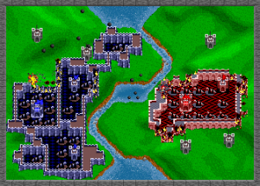
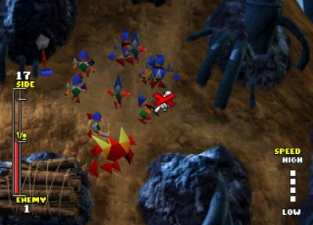
Introduction

Slide 4
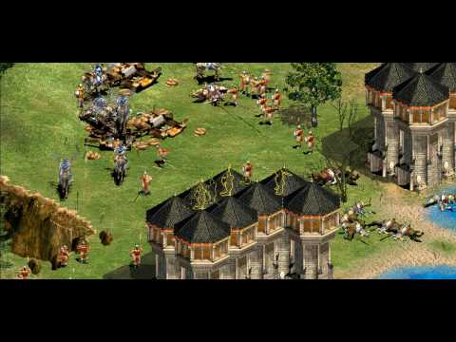
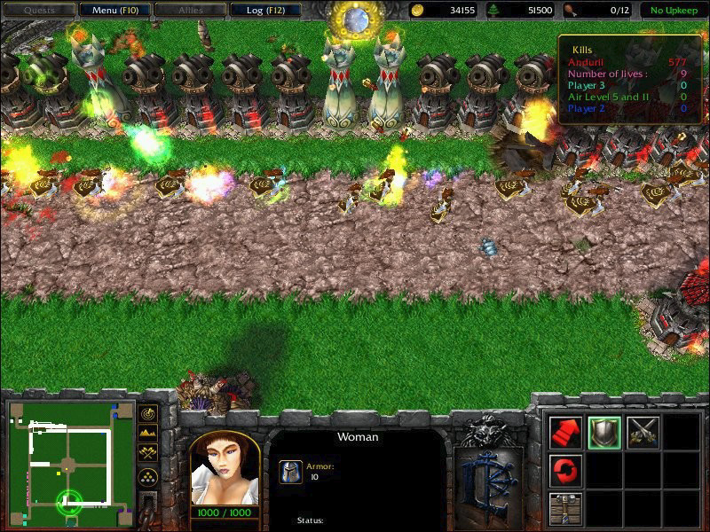
Introduction

Slide 5
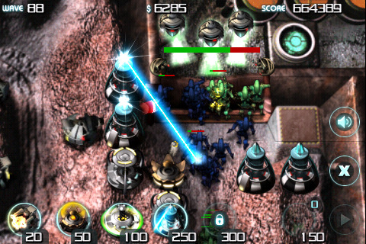
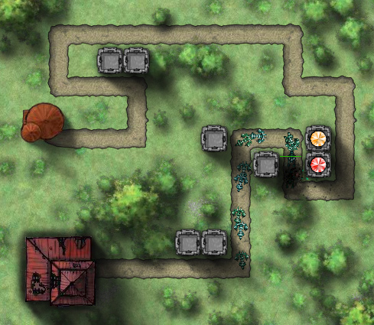
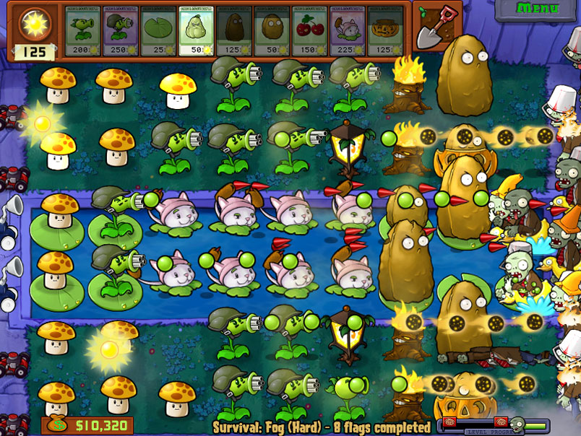
Introduction

Slide 6
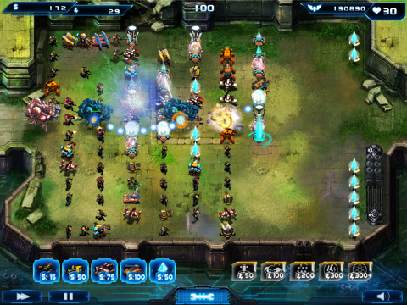
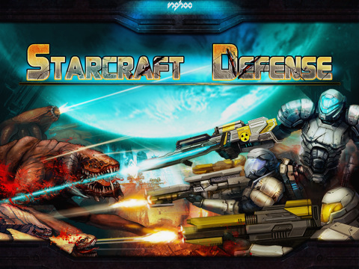
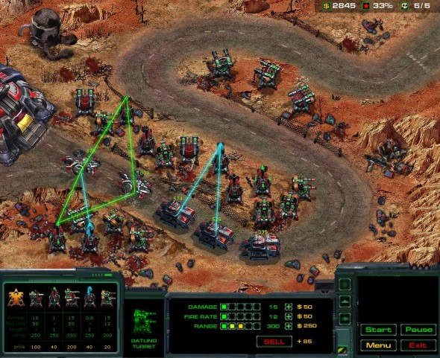
Introduction

Slide 7
Game flow

Slide 10


Slide 13

Loading

Slide 16

Sound on/off?

Slide 19
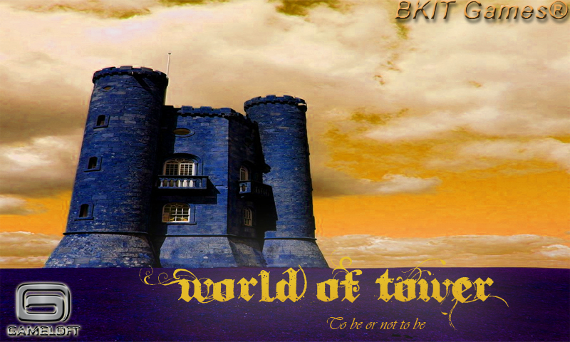
Flash

Slide 22

Main menu

Slide 25
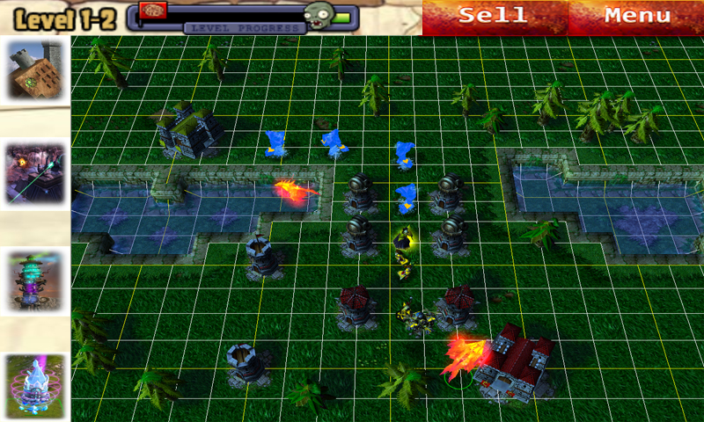
Game Playing

Slide 28
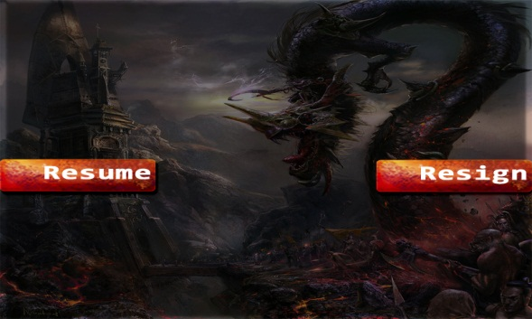
In-game menu

Slide 29

Confirm

Slide 30
Player (defender)

Slide 31
Unit description – defender (Player)
Gun Tower
Canon
Machine
Dead
Boost
Magic

Slide 32
Unit description – defender (Player)
Gun Tower
Canon
Machine
Dead
Boost
Magic

Slide 33
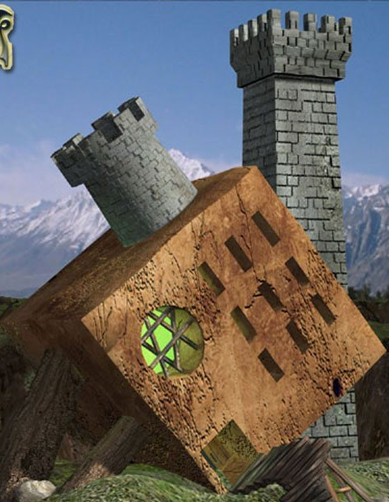
Unit description – defender (Player)
Canon
Bombard
Rocket

Slide 34
Unit description – defender (Player)
Gun Tower
Canon
Machine
Dead
Boost
Magic

Slide 35
Unit description – defender (Player)
Gun Tower
Canon
Machine
Dead
Boost
Magic

Slide 36
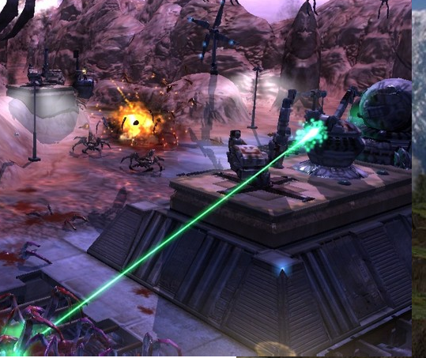
Unit description – defender (Player)
Machine gun
Laser gun

Slide 37
Unit description – defender (Player)
Gun Tower
Canon
Machine
Dead
Boost
Magic

Slide 38
Unit description – defender (Player)
Gun Tower
Canon
Machine
Dead
Boost
Magic

Slide 39
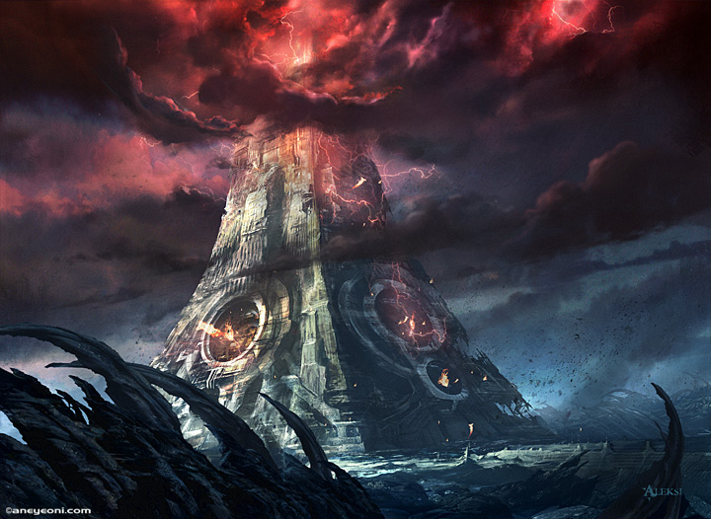
Unit description – defender (Player)
Dead Tower

Slide 40
Unit description – defender (Player)
Gun Tower
Canon
Machine
Dead
Boost
Magic

Slide 41
Unit description – defender (Player)
Gun Tower
Canon
Machine
Dead
Boost
Magic

Slide 42
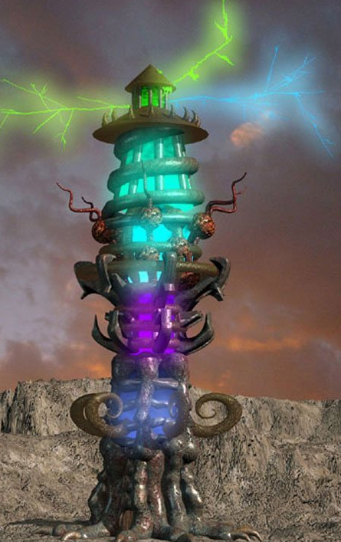
Unit description – defender (Player)
Boost
E - zone
C - zone
Nuclear

Slide 43
Unit description – defender (Player)
Gun Tower
Canon
Machine
Dead
Boost
Magic

Slide 44
Unit description – defender (Player)
Gun Tower
Canon
Machine
Dead
Boost
Magic

Slide 45
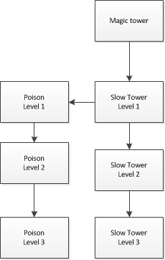
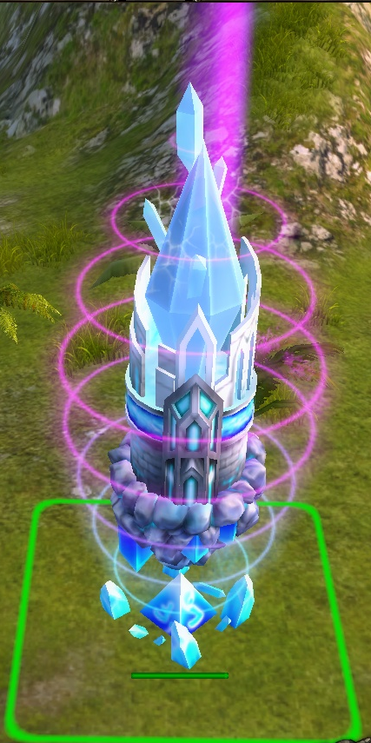
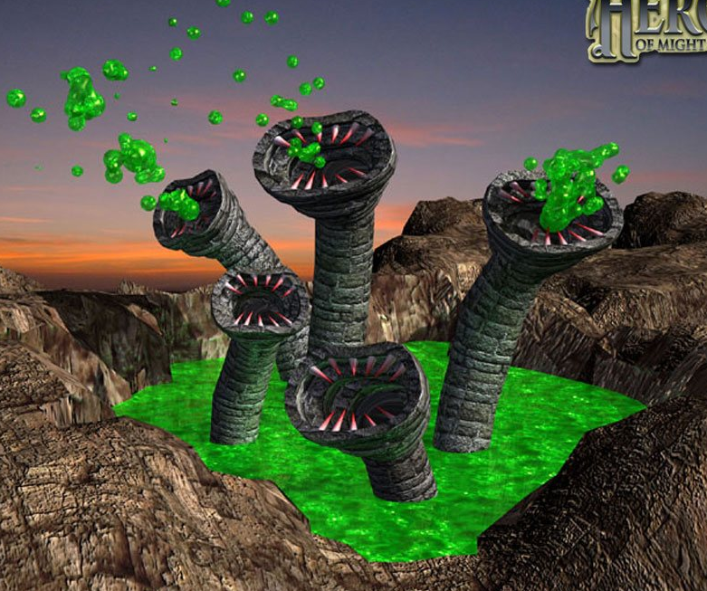
Unit description – defender (Player)
Magic
Slower
Poison

Slide 46
Computer (enemy)

Slide 47
Unit description – enemy (Computer)
Attribute | Description
Visible | Can see or not
Speed | How fast does he run?
Armor | Against damage
Flyable | Can fly or not
Hit point
Blind | Disable tower for a while

Slide 48
Unit description – enemy (Computer)
Name | HP | Armor | Speed | Special ability | Cost
Zergling | 50 | 1 | 5 |  | 7
Zealot | 100 | 5 | 3 |  | 20
Dragoon | 200 | 5 | 3 | Create 5 Dragoon Jr after deadth | 30
Dragoon Jr | 20 | 1 | 10 |  | 10
Hyralisk | 200 | 5 | 7 | Disable tower along their ways in 3s. Cool down: 6s | 40
Multalisk | 100 | 3 | 10 | Fly (invisible with Bombard Tower) | 50
Marine | 50 | 2 | 4 | Invisible when being out of tower’s sight | 40
Boss | 300 | 10 | 3 |  | 100

Slide 49
Game Properties

Slide 50
Game Properties
Map
Tower
Enemy unit
Damage Function

Slide 51
Game Properties - Map
Map is a 2mx2n matrix (tower placed in a 2x2 area)

Slide 52
Game Properties - Map
Length of a square is 10 in World Coord

Slide 53
Game Properties - Map
When touch on screen
Touch down và touch up in the same 2x2 area lead to a selection on that area

Slide 54
Game Properties - Tower
Place in 2x2 area
Place new tower only on grass
Can’t place new tower on an old tower
Tower ranage measured in World Coord.
No tower block any enemy ‘s way
Sell tower: lost 25%

Slide 55
Game Properties - Tower
Guntower attacks enemy:
Only in-range enemy
Priority
Nearest enemy
Attack enemy ‘til their death or out of range

Slide 56
Game Properties - Tower
Boost and Magic tower:
Cause effect on something in their range

Slide 57
Game Properties - Enemy
Enemy runs a long a shortest, 1-lenght wide street
No move top-left, bottom-down, etc.
Each enemy has its own source and destination place
When running, they can pass through each other (no collision)

Slide 58

Game Properties - Damage function
$$Crit?=isCrit(probability)$$
$$HP− =\left(damage\right)×(1−armor×0.1+Crit?×0.5)$$

Slide 59
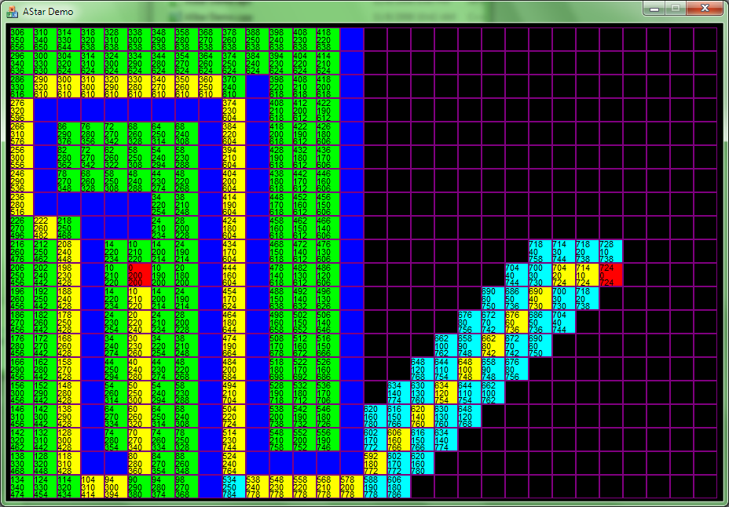
Game Properties - AI in game

Slide 60
Graphic effect

Slide 61


Graphic effect
Environment efection
Grass and tree:
Notes:
Rung rinh
Cỏ trên mặt đất sọc ca rô theo 2x2 để người dùng dễ tính toán khi xây tower

Slide 62

Graphic effect
Environment efection
River
Notes:
Có những chỗ k cho đặt tower thì đưa hiệu ứng nước chảy để thêm sống động

Slide 63
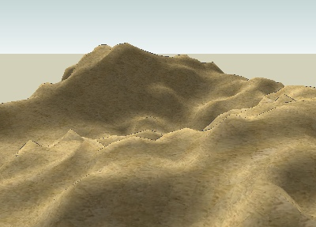
Graphic effect
Environment efection
Mountain

Slide 64
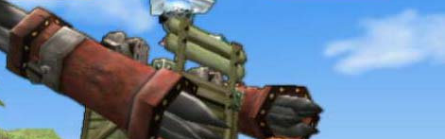
Graphic effect
Environment efection
Cloud

Slide 65
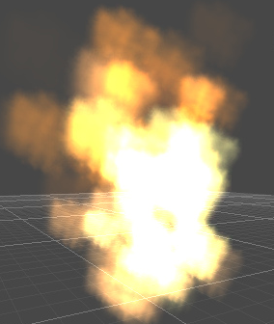
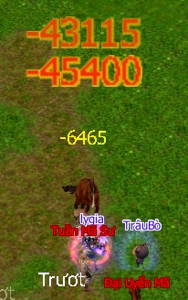
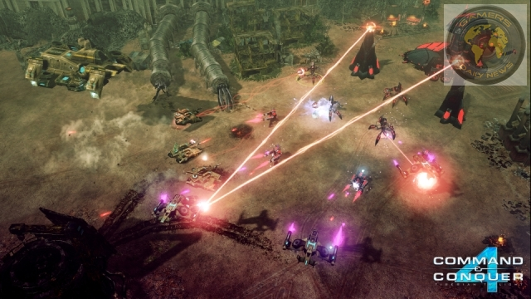
Graphic effect
Game-action
Killed & Explode

Slide 66
Planning
Done
Planning

Slide 67
Planning - Done
Framework
Animation
Sound Driver
Touch Management
Font
Specifications
Colision
Resources
Particles

Slide 68
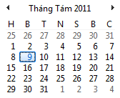
Planning
8/8 -> 19/8: alpha period
22/8 -> 2/9: beta period

Slide 69
Planning α - 8/8 -> 19/8
8-10: Design Data Structure, implement Game State
10-12: implement class for Game object: Map, Tower, Enemy, Environment
14-15: implement Game Objects' actions
16-19: finish and fix bug

Slide 70
Planning α 8/8 -> 19/8
Complete the core: can play a simple level such as a straightforward street.
Simple enemy, no need special ability
Simple tower: Gun tower

Slide 71
Planning β 22/8 -> 2/9
22-26: special tower, special enemy, environment effect
29-2: finish and fix bug, add more advanced effect

Slide 72
Thank you

